Slide 1

Multi-Media API

Slide 2
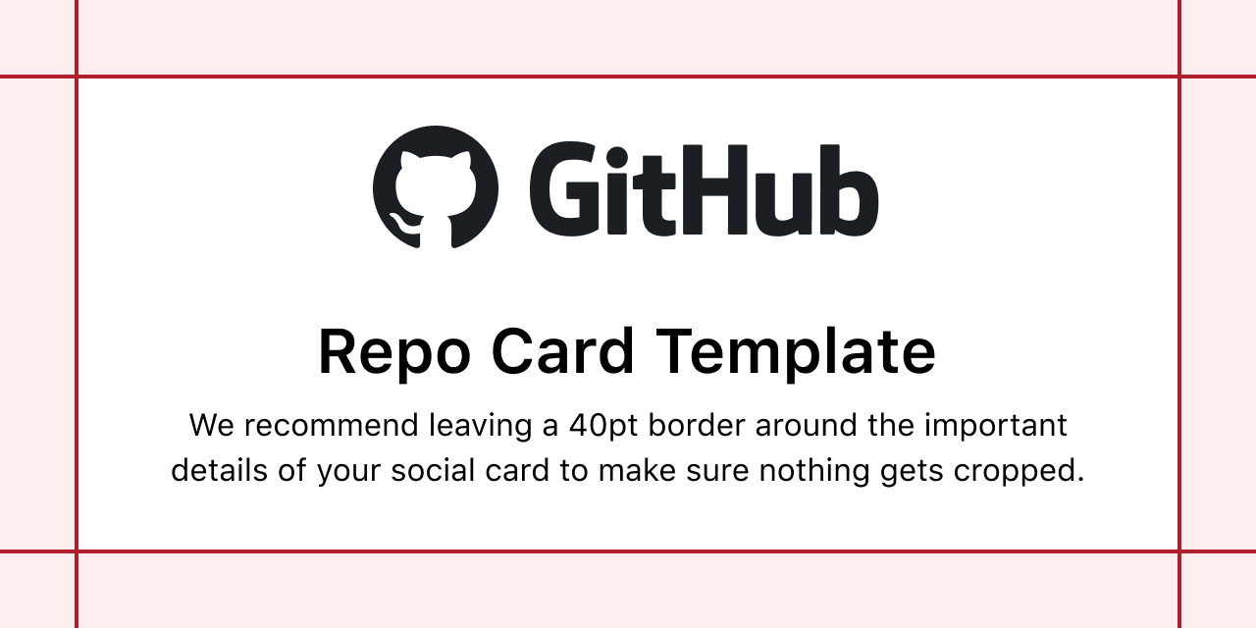

Multi-Media API

Slide 3


Slide 4


Slide 5


